Slide 1
Sokoban Game Player
By Timothy Aitchison

Slide 2
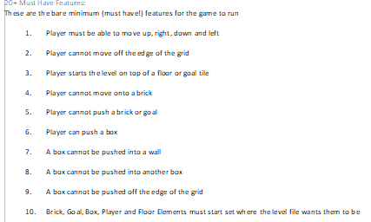
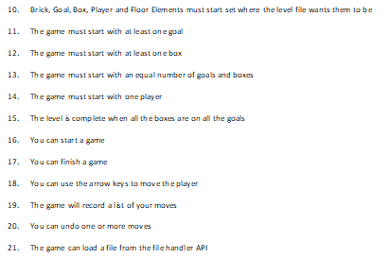
Sokoban Game Player
21 Requirements (by team groupname)

Slide 3
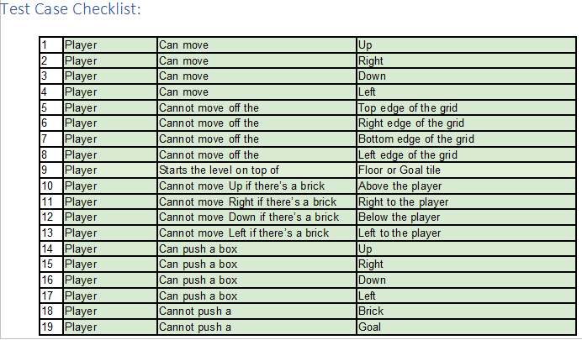
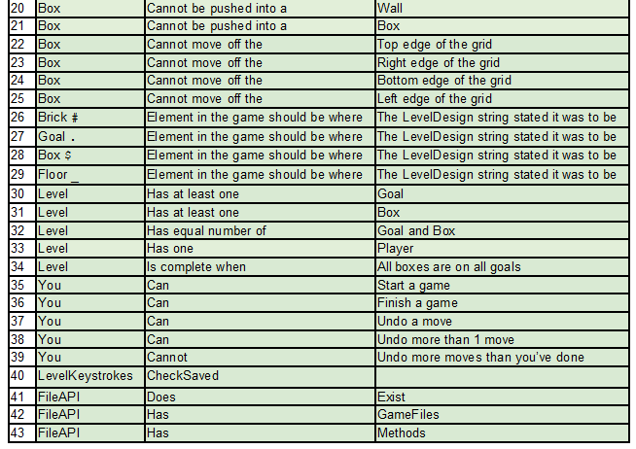
Sokoban Game Player
From the 21 requirements, 43 tests with full coverage
43 test cases, each one with one unit test,
by team groupname

Slide 4
Sokoban Game Player
TLDR: 21 requirements met, all tests passed,
including made some extra ones for missing coverage
The one requirement not met was not a
MODEL requirement
Substituted one of my own instead, not good practice in
real world to make up requirements but marking guide
says needs more than 20

Slide 5
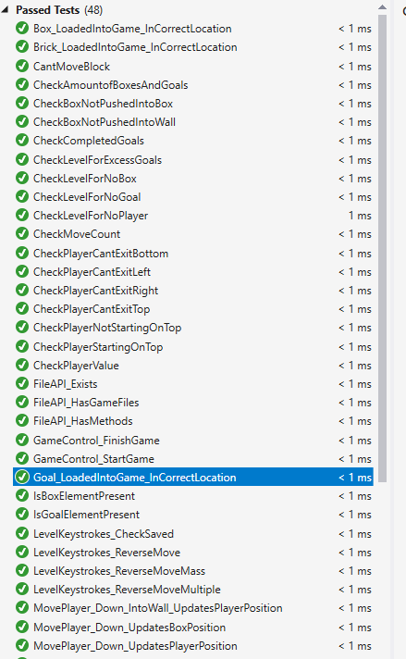
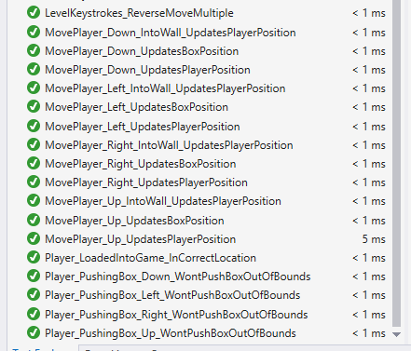
Sokoban Game Player
Tests passing

Slide 6
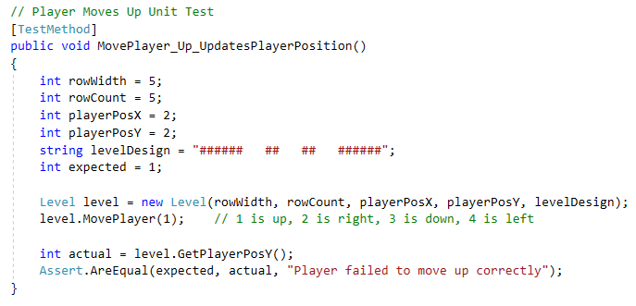
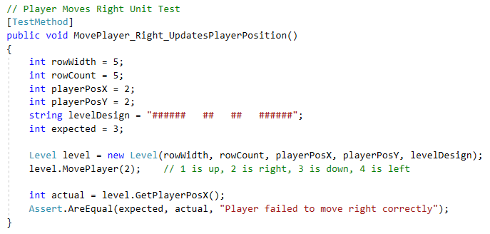
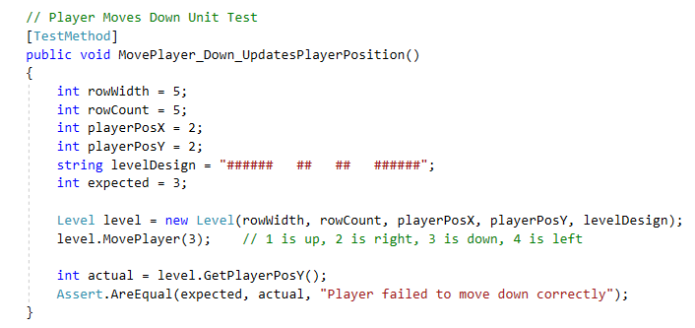
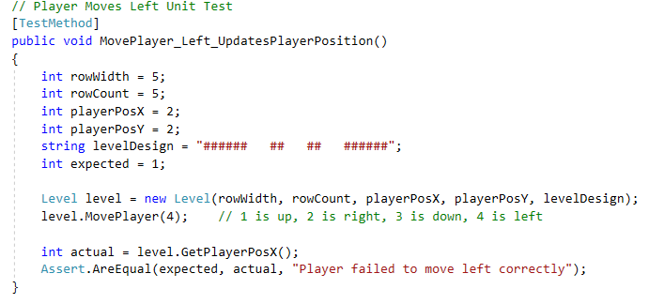
Sokoban Game Player
Requirement 1: Player Movement

Slide 7
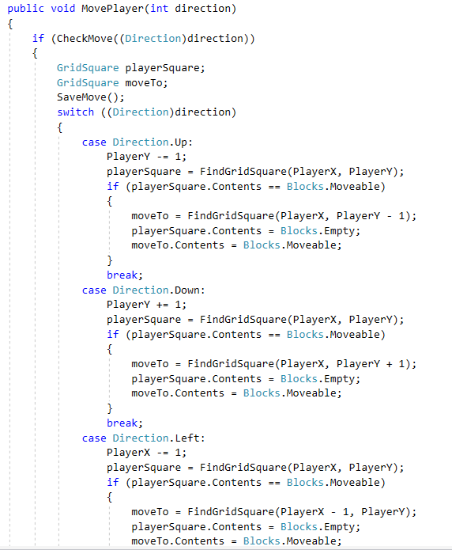
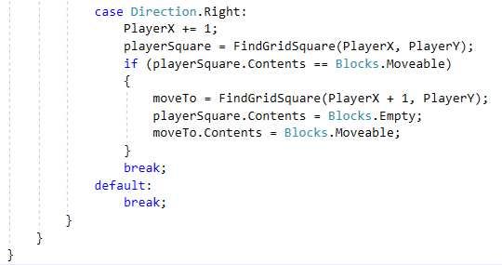
Sokoban Game Player
Code:

Slide 8
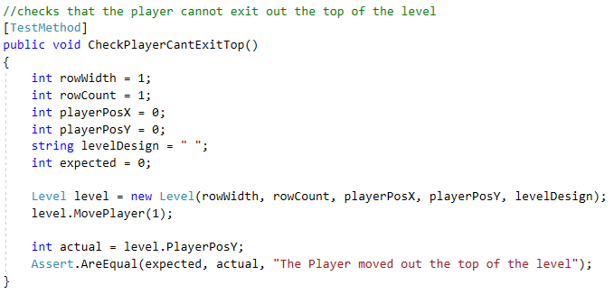
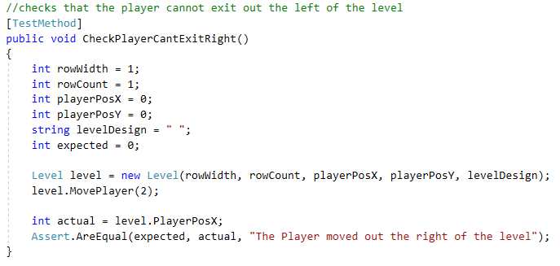
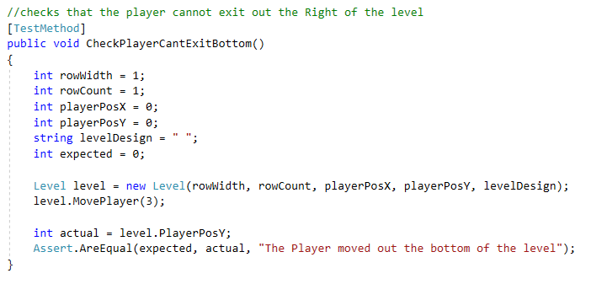
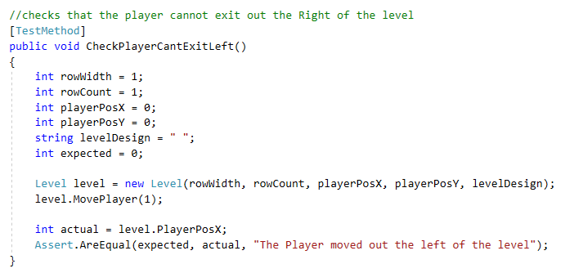
Sokoban Game Player
Requirement 2: not moving out of level

Slide 9
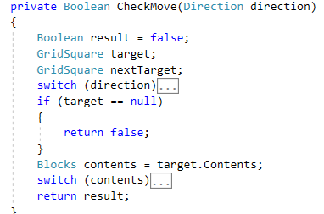
Sokoban Game Player
Code:
The checking target for null means if the
square to move into isn't in the grid then the checkmove
returns false I.e. the move is not performed

Slide 10
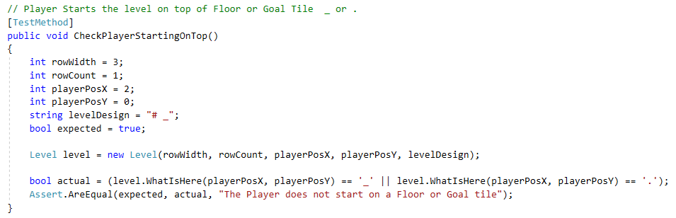
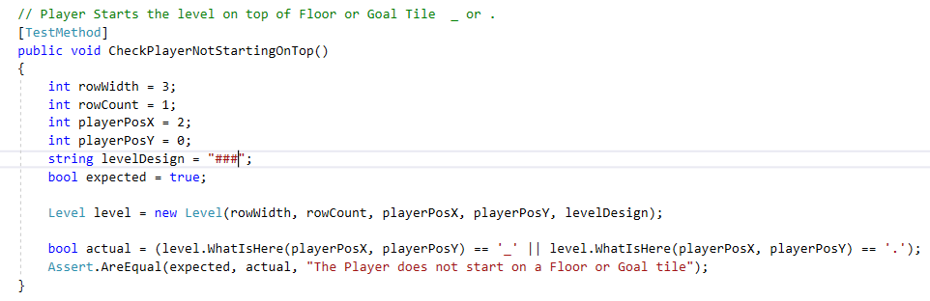
Sokoban Game Player
Requirement 3: player starts on floor or goal
This is actually not quite right (provided test)
This test is better (my test)

Slide 11

Sokoban Game Player
Code:
According to the requirements, player must start on a “floor” tile
That is different to empty (floor is '_' and empty is ' '
So we just make the starting tile floor if it isn't already

Slide 12
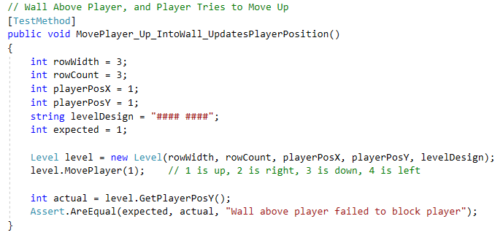
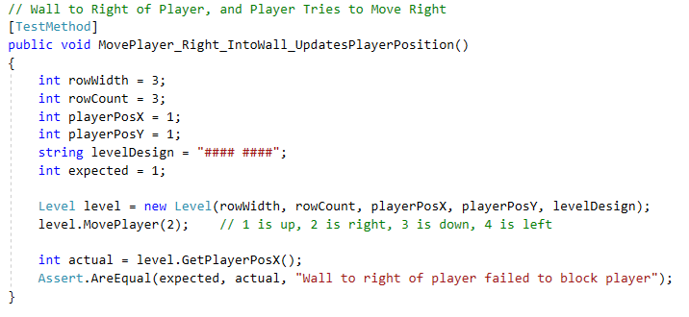
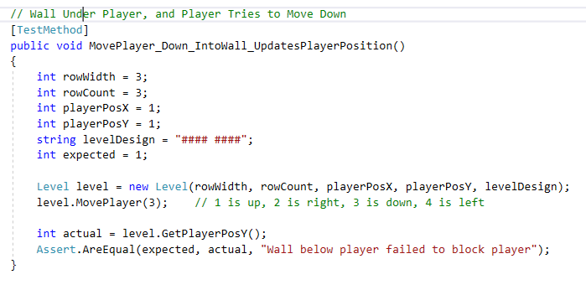
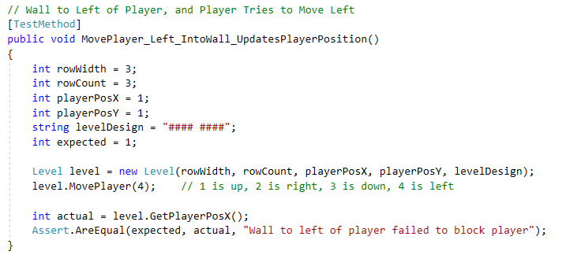
Sokoban Game Player
Requirement 4: Player can't move onto a brick

Slide 13
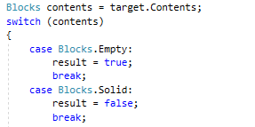
Sokoban Game Player
Code:
We return false for the check method if the target square
is a solid block

Slide 14
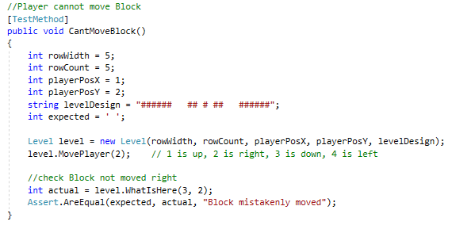
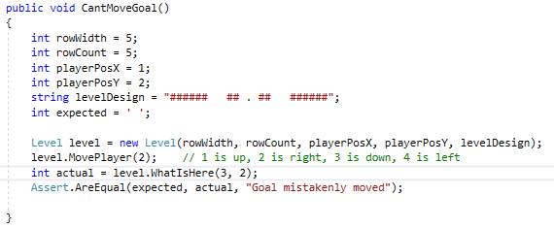
Sokoban Game Player
Requirement 5: Can't move brick or goal
(the solid unmovable ones)

Slide 15
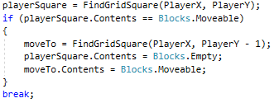
Sokoban Game Player
Code:
The code to move blocks only checks for moveable
not any other type

Slide 16
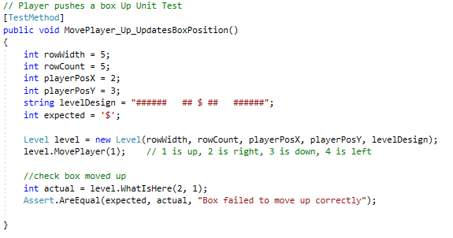
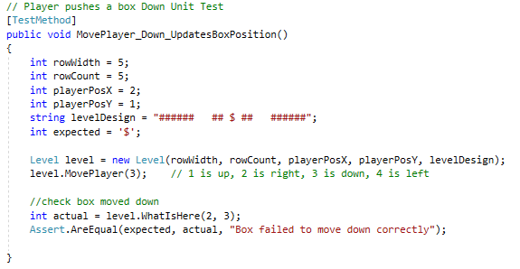
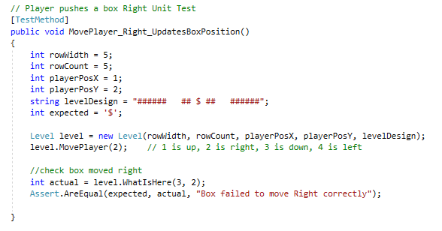
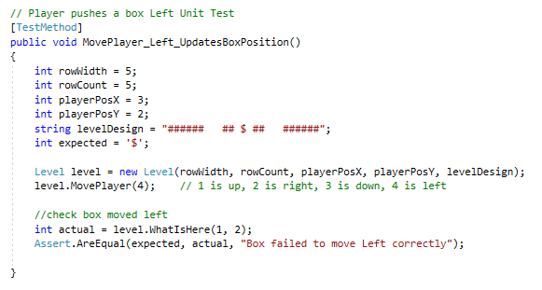
Sokoban Game Player
Requirement 6: player can move movable block

Slide 17
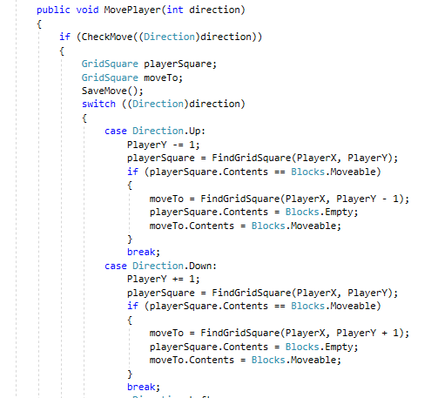
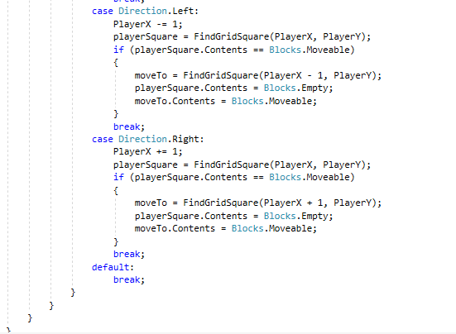
Sokoban Game Player
Code:

Slide 18
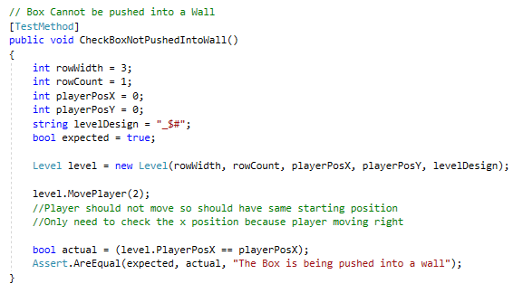
Sokoban Game Player
Requirement 7: box not pushed into wall

Slide 19
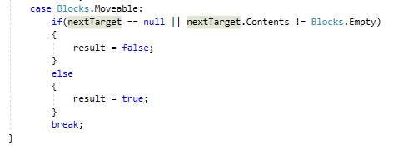
Sokoban Game Player
Code:
Trying to move into a square with a moveable is only
legal if the square one more in that direction is empty
and exists

Slide 20
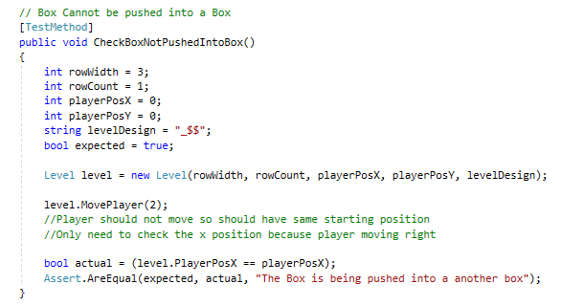
Sokoban Game Player
Requirement 8: box not pushed into box

Slide 21
Sokoban Game Player
Code:
Trying to move into a square with a moveable is only
legal if the square one more in that direction is empty
and exists

Slide 22
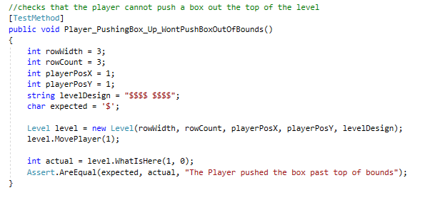
Sokoban Game Player
Requirement 9: box not pushed outside

Slide 23
Sokoban Game Player
Code:
Trying to move into a square with a moveable is only
legal if the square one more in that direction is empty
and exists

Slide 24
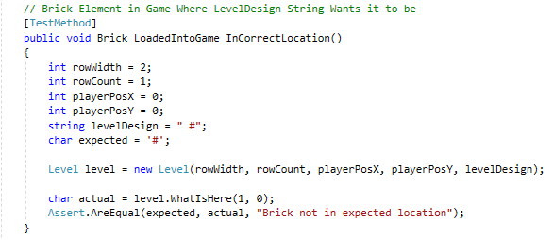
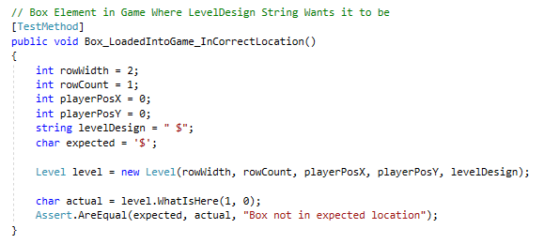
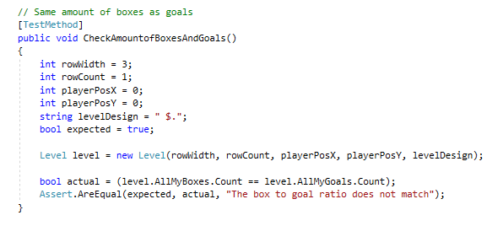
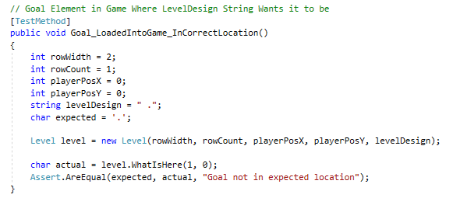
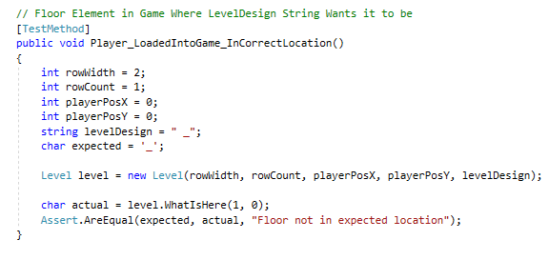
Sokoban Game Player
Requirement 10: everything starts where it should

Slide 25
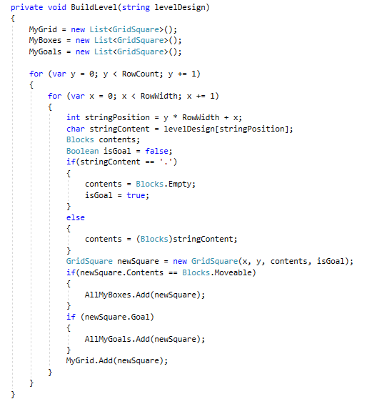
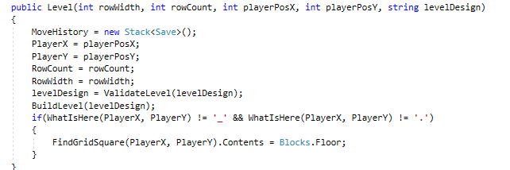
Sokoban Game Player
Code:

Slide 26
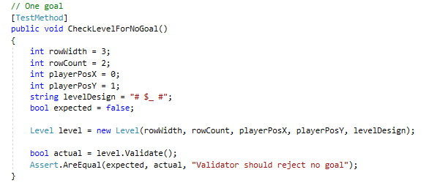
Sokoban Game Player
Requirement 11: Has a goal

Slide 27
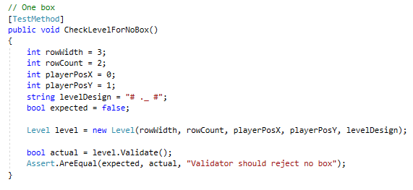
Sokoban Game Player
Requirement 12: Has a box

Slide 28
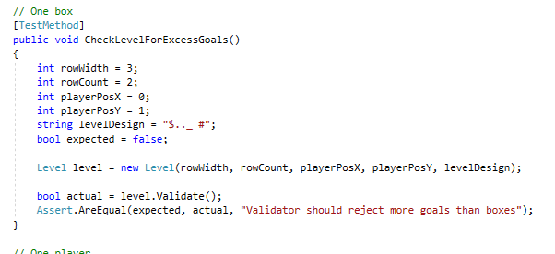
Sokoban Game Player
Requirement 13: Has equal boxes and goals

Slide 29
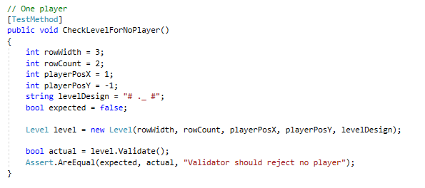
Sokoban Game Player
Requirement 14: Has a player

Slide 30
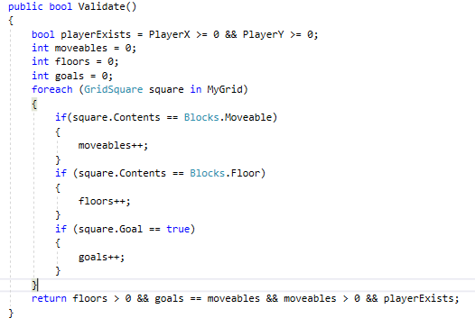
Sokoban Game Player
Code:
This does multiple requirements

Slide 31
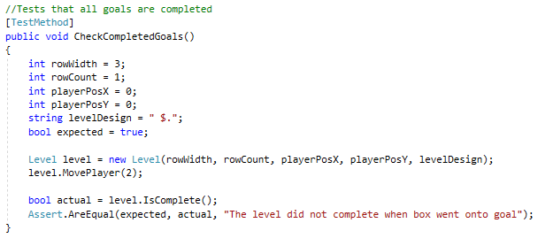
Sokoban Game Player
Requirement 15: Level Completes

Slide 32

Sokoban Game Player
Code:

Slide 33

Sokoban Game Player
Requirement 16: Start a game

Slide 34

Sokoban Game Player
Code:

Slide 35

Sokoban Game Player
Requirement 17: Finish a game

Slide 36
Sokoban Game Player
Code:

Slide 37

Sokoban Game Player
Requirement 18: arrow keys to move player
This is not part of MODEL so has been skipped
Instead, keep track of movecount

Slide 38


Sokoban Game Player
Code:

Slide 39

Sokoban Game Player
Requirement 19: Records moves

Slide 40

Sokoban Game Player
Code:

Slide 41

Sokoban Game Player
Requirement 20: Undoes moves

Slide 42

Sokoban Game Player
Code:

Slide 43

Sokoban Game Player
Requirement 21: Load file from filehandler API

Slide 44

Sokoban Game Player
Code:

Slide 45
Sokoban Game Player
Diagrams by team groupname
Note some View stuff is in here too, only MODEL
stuff is implemented

Slide 46

Sokoban Game Player - Class

Slide 47

Sokoban Game Player - Activity

Slide 48

Sokoban Game Player - Component

Slide 49

Sokoban Game Player - Usecase

Slide 50

Sokoban Game Player - Sequence

